Slide 1
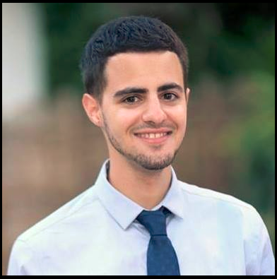
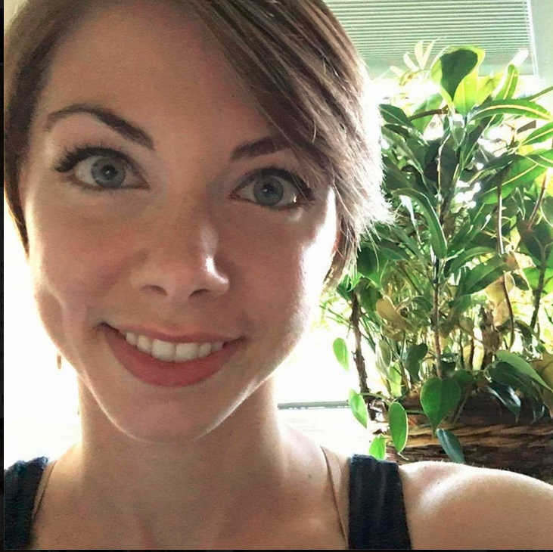
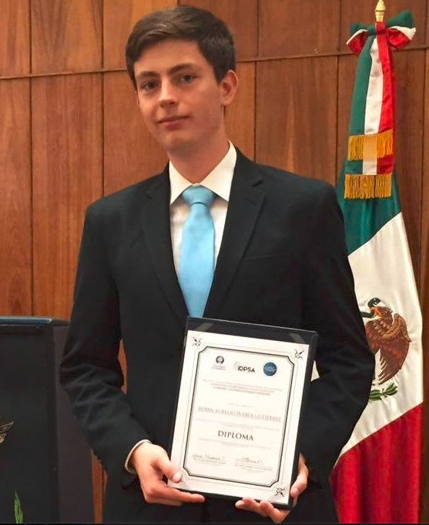
Team 234 Sprint 2 CaPS WebApp
Gal fisher [GFISHER]
Laura Miller [lauramil]
Ruben Aurelio Puebla Gutierrez (Sprint master) [rpueblag]

Slide 2
Idea & Specification
Create a web app that will lower the “activation energy” for students to get psychological help. Extend CaPS capabilities through a comprehensive site to receive different kinds of services and treatments. Build an online framework for diagnosis and therapy.
Emergency Chat
Admin Site
Receptionist Chat
Tasks Framework
CaPS
Main Site
Exercises
Counselor Chat
Testing
Profile Management

Slide 3
Sprint 2 Backlog
Task |  | Owner | Done?
Front-End | Django Templates | Laura | v
 | CaPS Static pages & style |  | v
 | Tasks Front-End |  | v
Back-End - CaPS | CaPS Models | Gal | v
 | CaPS Forms |  | v
 | CaPS Views |  | v
Tasks Framework | Tasks Models | Aurelio | v
 | Tasks API – Back-End |  | v
 | Tasks API – AJAX |  | v
 | Admin Site |  | v
Testing | 100% coverage for CaPS (Full-Stack) | Everyone | V (110+)

Slide 4
Retrospective
Integrating multiple technologies (Websockets, AJAX, Django…)
Designing and implementing an Independent Framework
Testing the Full Stack (Front-End tests, Chat tests, Back-End tests).

Slide 5
Sprint 3 goals
- Testing Task Framework
- Testing + Improving Usability
- Adding Compatibility Measure Quiz
- Deploying

Slide 6

Questions?
Thanks for listening!

